Slide 1

$Poisson$ GLMs
How many?

Slide 2
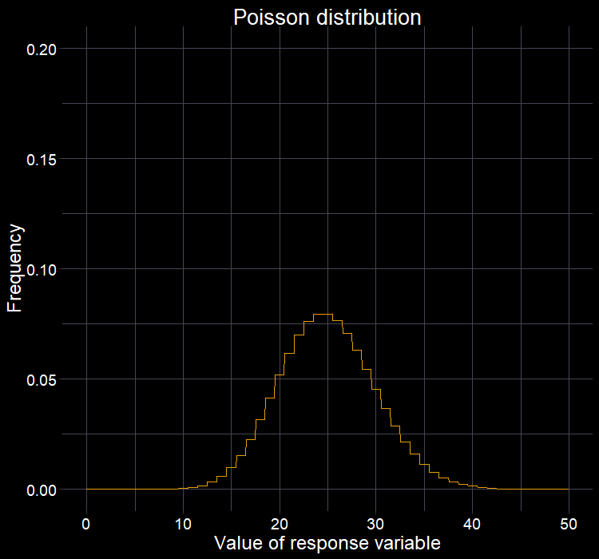
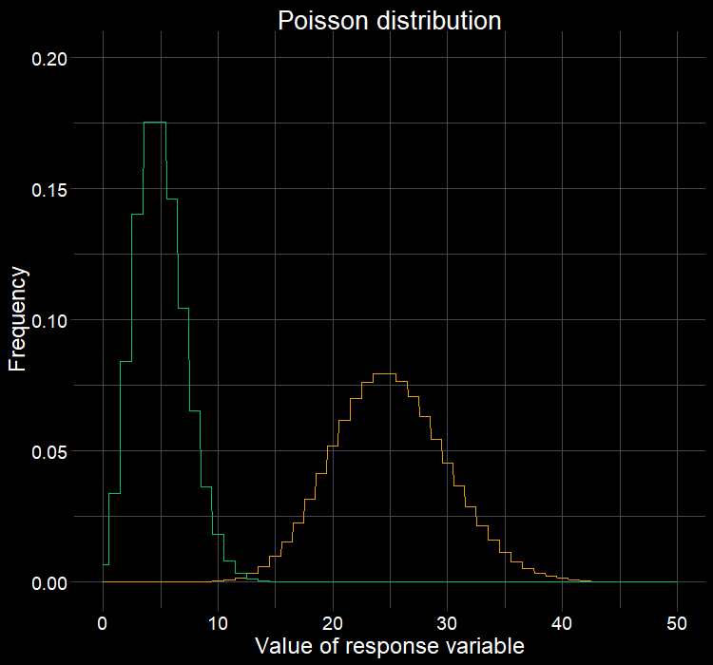






The $Poisson$ distribution
$$λ=5$$
$$Poisson(λ_{i})$$
$λ$ (rate) is both the mean and variance
Captures data that:
  Are integers (0, 1, …, $∞$).
  Non-negative.
  Has more variation as average gets larger.
So works very well for many datasets, e.g.:
  Counts of entities
$$λ=25$$
$$λ=5$$
$$λ=25$$

Slide 3
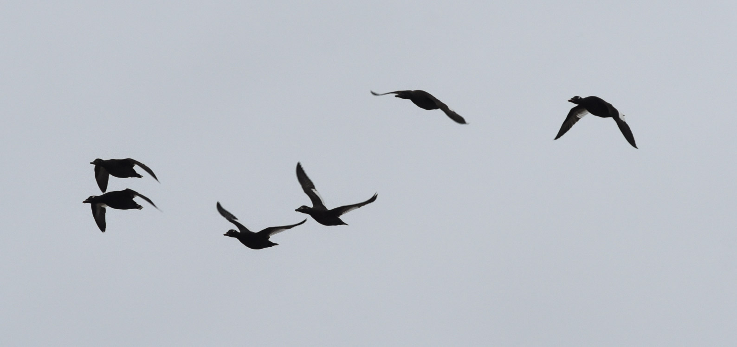
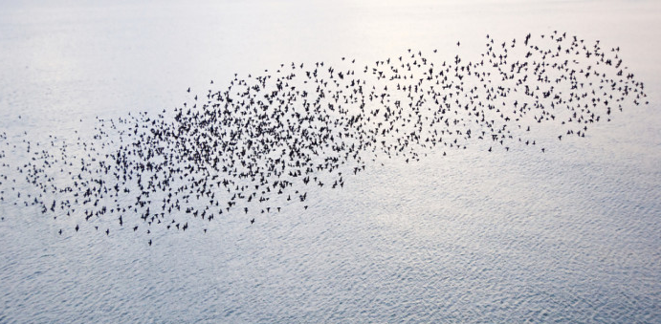
“Has more variation as average gets larger”
Species A:
Small flock size, small variation between flocks
Assumption:
The mean is equal to the variance at 1:1 ratio (called dispersion)
Species B:
Large flock size, large variation between flocks

Slide 4


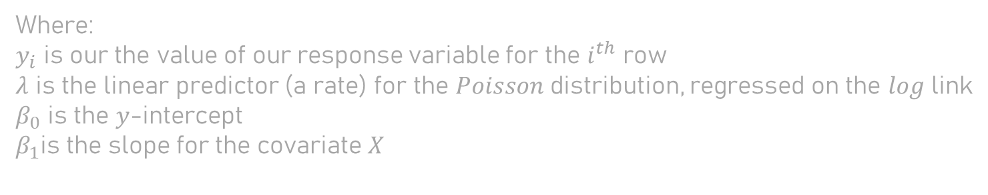
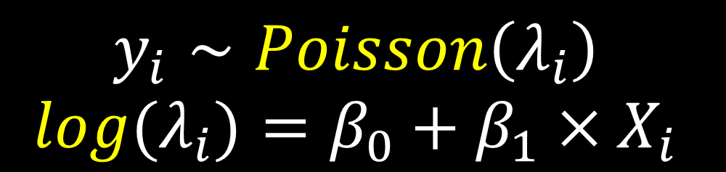
$Poisson$ link function
The default link function used in $Poisson$ GLMs is the $log$ link function.
$log$ is how we ensure that the predicted values of $y$ are $≥0$
  But there are other options
  E.g. Complimentary log-log
$$y_{i}∼Poisson\left(λ_{i}\right) \\ log⁡(λ_{i})=β_{0}+β_{1}×X_{i}$$
Where:
$y_{i}$ is our the value of our response variable for the $i^{th}$ row
$λ$ is the linear predictor (a rate) for the $Poisson$ distribution, regressed on the $log$ link
$β_{0}$ is the $y$-intercept
$β_{1}$is the slope for the covariate $X$

Slide 5
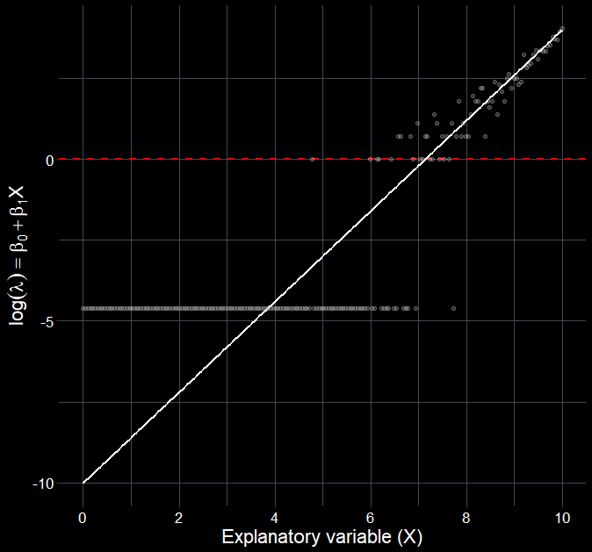
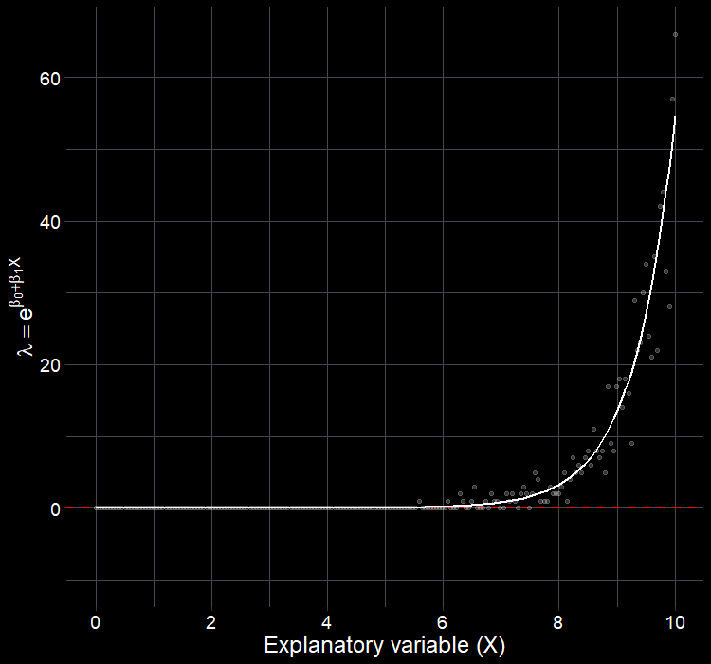
$Poisson$ link function
What the model is fitting a straight line through
What we can then extract after the model is fit

Slide 6
The question

Slide 7
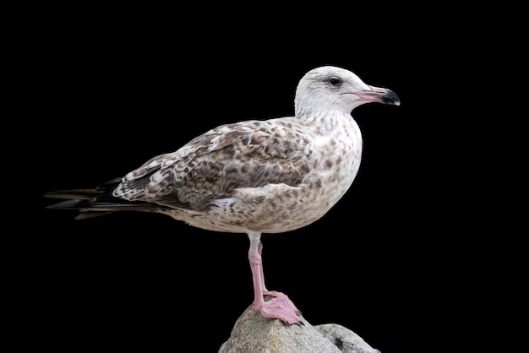
  What determines the number of seabirds that collide with wind turbines?

Slide 8
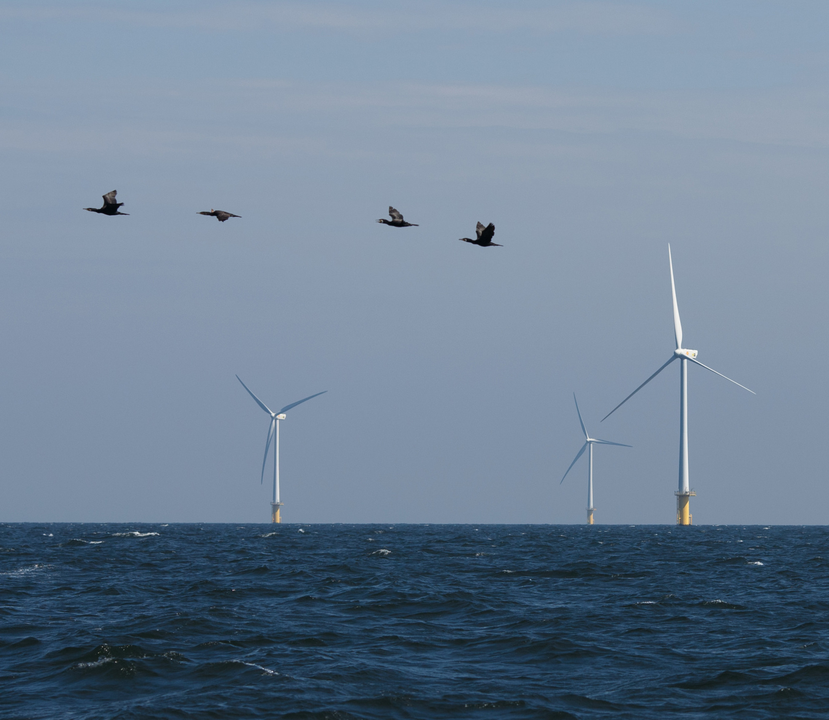
What determines bird-turbine collisions?
Movement towards renewables could impact already struggling species.
How many birds collide with turbines?
  Does distance from nearest colony have any relationship with the number of collisions?
  How big is this effect?
  Are some species at higher risk?

Slide 9
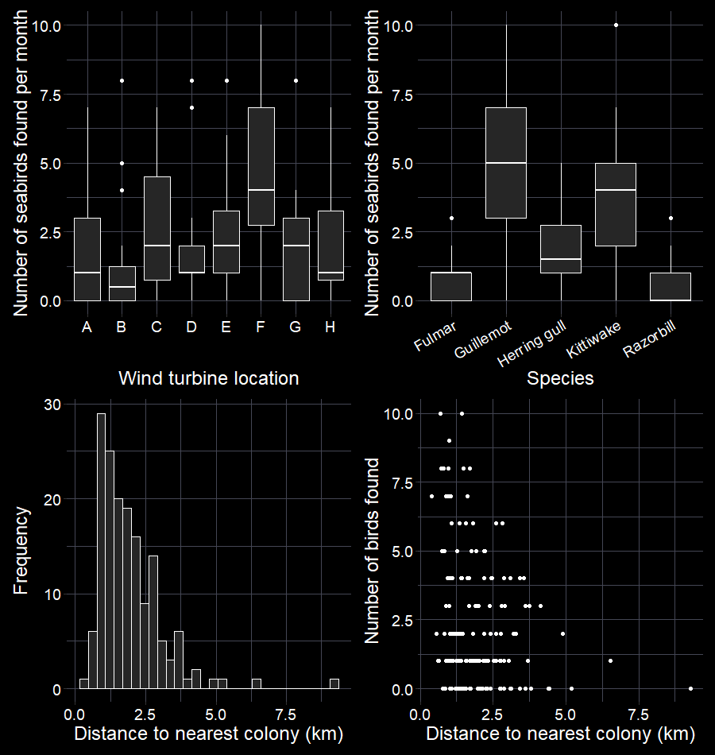
What determines bird-turbine collisions?
8 wind turbine locations across Scotland.
In each location, every month we record:
  Number of dead seabirds per species.
  What the species was.
  Distance to nearest colony for that species.
  Which location data was collected from.
Plot your data!

Slide 10

Translating our question into models
Our question relates primarily to number of birds found as a function of distance to nearest colony
  So: found ~ dist2col
  Or: $\log\left(λ_{i}\right)=β_{0}+β_{1}×D_{i}$

Slide 11



Running a GLM in R
The function glm() will run a generalised linear model.
The arguments:
  Response as a function of X:
    formula = found ~ dist2col
  We assume a $Poisson$ distribution and $log⁡$ link
    family = poisson(link = “log”)
  Tell the model where to find the data
    data = birds
Remember to store your model object
$$y_{i}∼Poisson\left(λ_{i}\right) \\ log⁡(λ_{i})=β_{0}+β_{1}×D_{i}$$

Slide 12
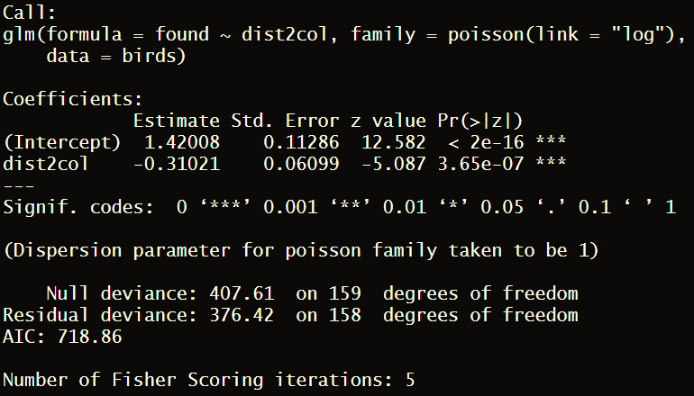
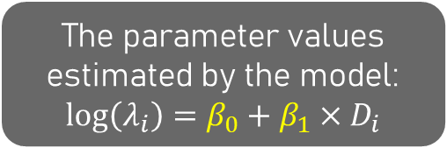
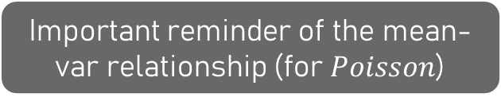
What does summary() say?
A reminder of the model we ran
The parameter values estimated by the model:
$$\log\left(λ_{i}\right)=β_{0}+β_{1}×D_{i}$$
Important reminder of the mean-var relationship (for $Poisson$)
Null Dev: Lack-of-fit for intercept only model
Resid Dev: A measure of lack-of-fit from current model
The number of attempts
the algorithm needed to estimate parameters

Slide 13
Diagnose

Slide 14


What does summary() say?
A quick crude way to check:
Dispersion $=θ=\frac{D}{n−p}$
  $D$ is the residual deviance
  $n−p$ is the degrees of freedom
  $θ$ must equal 1 for $Poisson$ requirement to be met
  If $θ<1$, then maybe underdispersed
  If $θ>1$, then maybe overdispersed
But! $θ=1.1$ and $θ=1.7$ are very different beasts
Here, $θ=\frac{376.42}{158}=2.4$
Not meeting $Poisson$ assumption

Slide 15
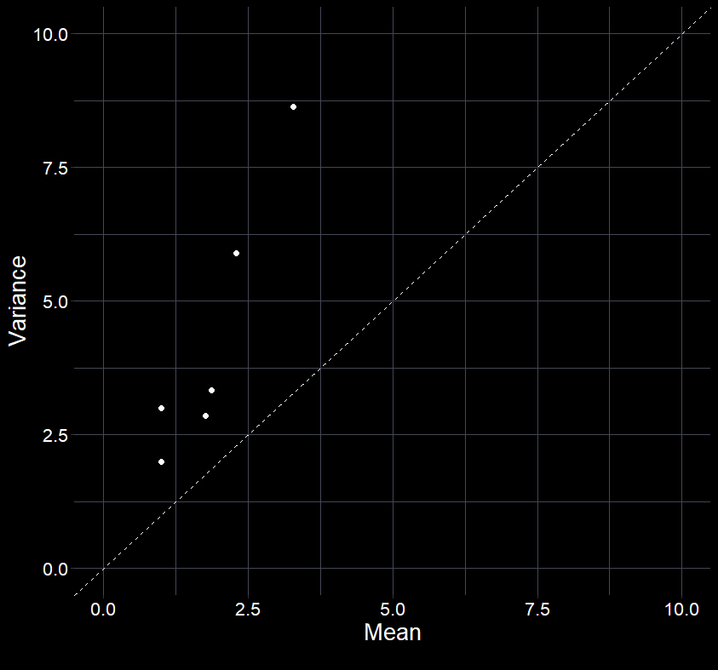


What is over-dispersion?
Variance higher than mean
Can occur because of:
  Model misspecification
  Excess zeroes
  Non-independence
Consequences:
  Biassed standard errors
  Biassed parameter estimates
  Type 1 errors for P-values
Solutions:
  Add “missing” covariates
  Change distribution
    E.g. ZIP, $Negative Binomial$,
    “quasi-$Poisson$”
  Change model
    E.g. GLMM, $Poisson−Normal$ Model
$$Var\left(y\right)=λ=E(Y)$$

Slide 16
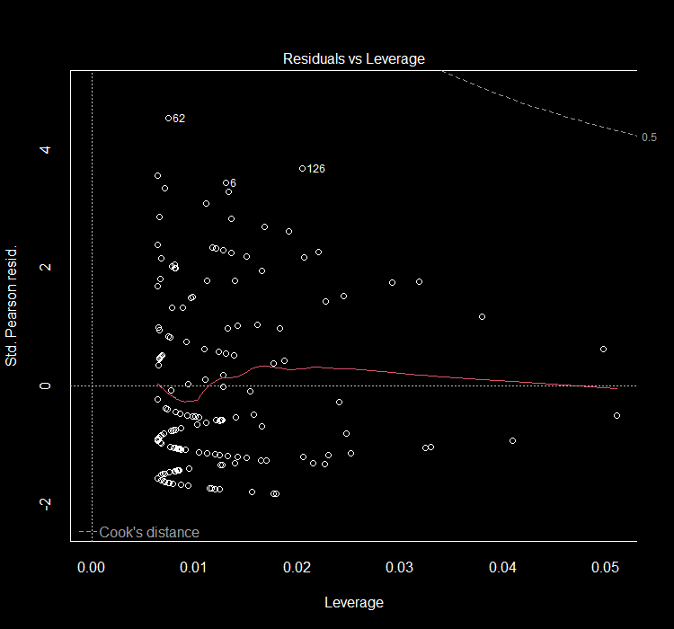
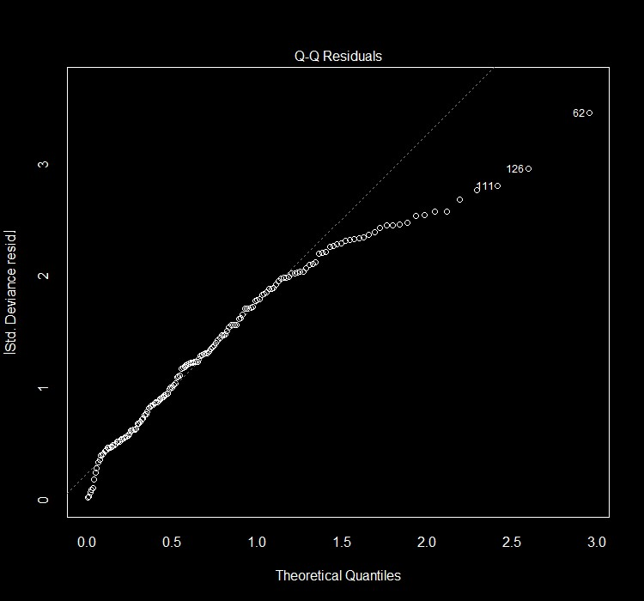
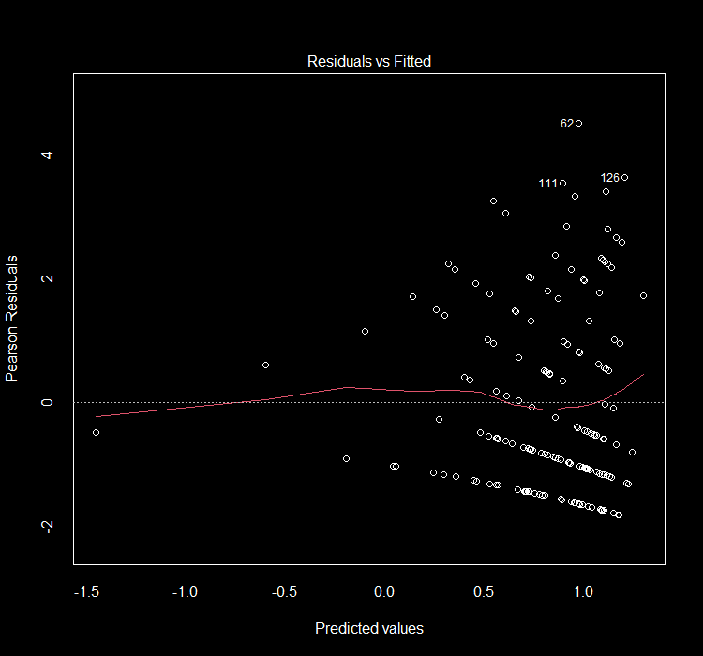
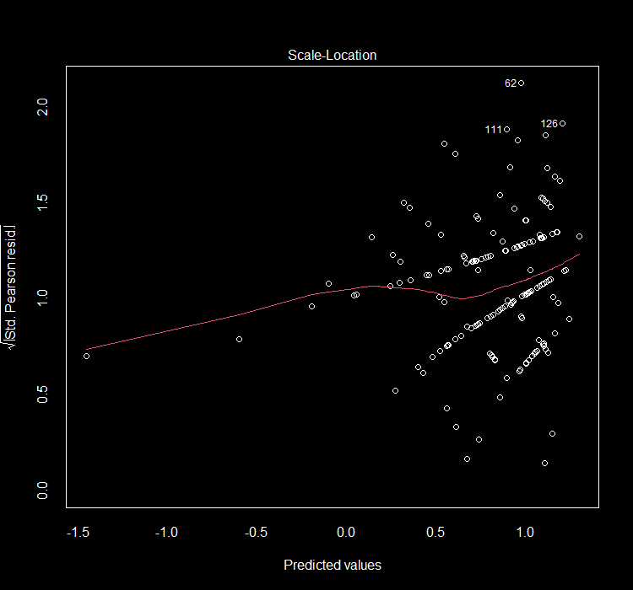
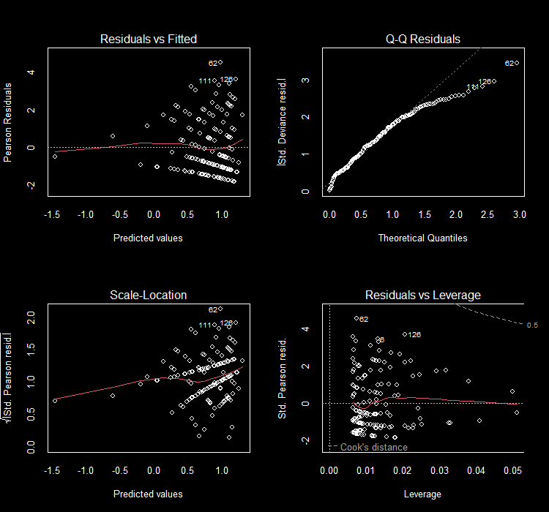
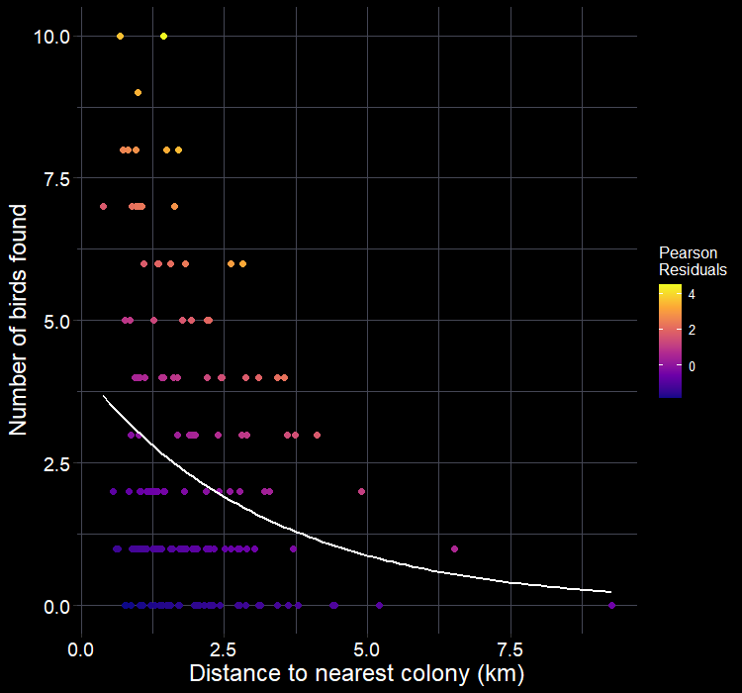

Diagnose model
The diagnoses of this $Poisson$ GLM are concerning
Residuals vs Fitted
  “Bands” are common
  Using Pearson residuals, we should see constant variation
Scale-Location
  Equal variation across predicted values (on link scale)?
Q-Q Residuals
  Are we expecting Normal residuals?
Residuals vs Leverage
  No points close to Cook’s = 1 line

Slide 17
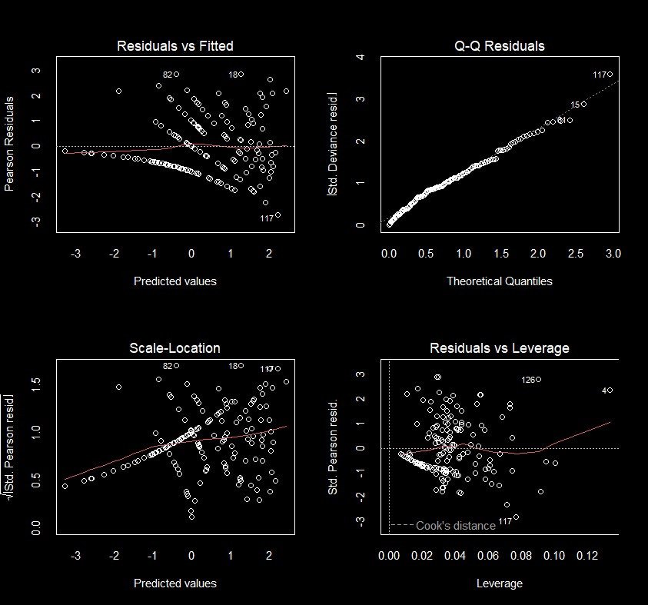


Let’s try another model
Two separate checks suggested problems
We’ll try a more complex model to see if that solves our apparent overdispersion
We now include species as a fixed effect
$$θ=\frac{159.99}{154}=1.04$$

Slide 18
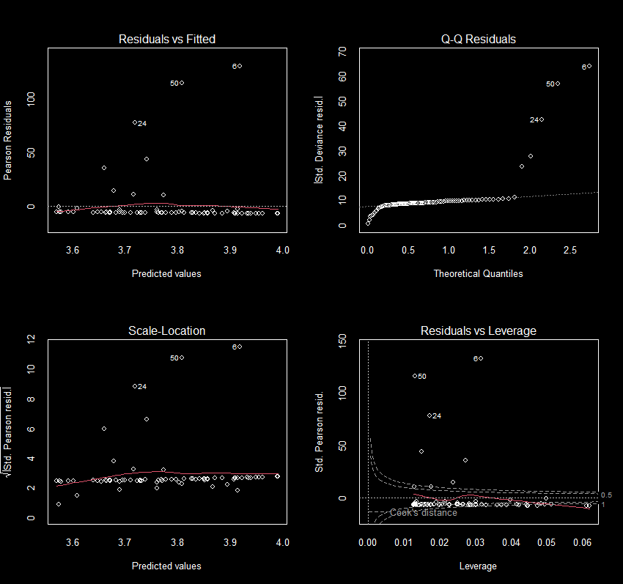

It can always be worse
This model uses data simulated using a $Poisson$ distribution
But the simulation is far more complex than the model accounts for
  The model is missing important covariates
In this case, resulting in overdispersion ($θ=5.4$) and poor model diagnostics

Slide 19
Inference

Slide 20

What have we learnt?
Our equation for model 2:
$$\log\left(λ_{i}\right)=β_{0}+β_{1}×D_{i}+β_{2}×Gui_{i}+β_{3}×Her_{i}+β_{4}×Kit_{i}+β_{5}×Raz_{i}$$
Is now estimated as:
$$\log\left(λ_{i}\right)=0.8+−0.6×D_{i}+1.9×Gui_{i}+0.8×Her_{i}+1.7×Kit_{i}+−0.3×Raz_{i}$$
$β_{0} \text{defaults} \text{to} \text{Fulmars}$
$β_{2,3, 4, 5}$ are contrast treatments.
  I.e. difference between fulmars and the given species
> summary(mod2)
Call:
glm(formula = found ~ dist2col + species, family = poisson(link = "log"), data = birds)
Coefficients:
Estimate Std. Error z value Pr(>|z|)
(Intercept) 0.81742 0.21359 3.827 0.00013 ***
dist2col -0.64423 0.07222 -8.920 < 2e-16 ***
speciesGuillemot 1.86896 0.20002 9.344 < 2e-16 ***
speciesHerring gull 0.77691 0.25645 3.029 0.00245 **
speciesKittiwake 1.64967 0.20744 7.953 1.83e-15 ***
speciesRazorbill -0.27517 0.27921 -0.986 0.32437
---
Signif. codes: 0 ‘***’ 0.001 ‘**’ 0.01 ‘*’ 0.05 ‘.’ 0.1 ‘ ’ 1

Slide 21
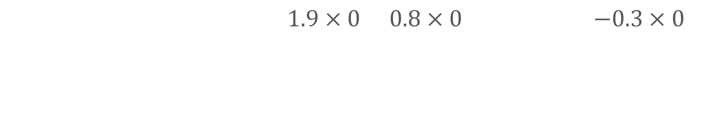

What have we learnt?
$$\log\left(λ_{i}\right)=0.8+−0.6×D_{i}+1.9×Gui_{i}+0.8×Her_{i}+1.7×Kit_{i}+−0.3×Raz_{i}$$
How many Kittwakes do we expect
to find at a turbine, if the nearest colony
was 5 km away?
$$\log\left(λ_{i}\right)=0.8+−0.6×5+1.9×0+0.8×0+1.7×1+−0.3×0$$
$$=0.8+−3+1.7$$
$=−0.5$
$$λ_{i}=e^{−0.5}=0.6$$

Slide 22
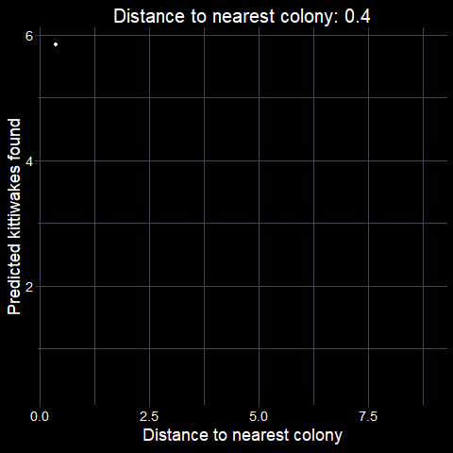
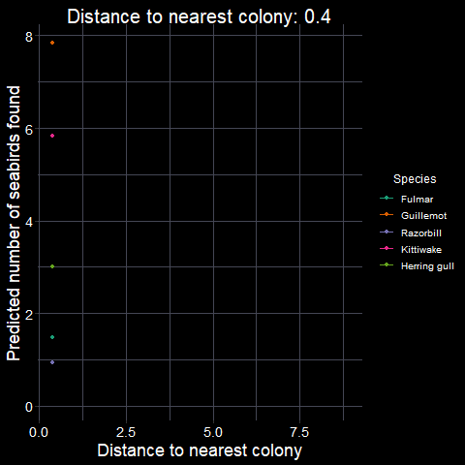

Full predictions
We can repeat this process for the full range of distances for Kittiwakes
If we want this for each species, we can then “turn on” the prediction for a given species
  E.g. for guillemots, set $GUI=1$ and $Her, Kit, Raz=0$
$$λ=exp⁡(β_{0}+β_{1}×D_{i}+β_{2}×Gui_{i}+ \\ β_{3}×Her_{i}+β_{4}×Kit_{i}+β_{5}×Raz_{i})$$

Slide 23

Returning to answer our questions
Our questions:
Does distance from nearest colony have any relationship with the number of collisions?
How big is this effect?
Are some species at higher risk?
Our answers:
  “Yes, we find that turbines closer to colonies have more collisions.”
  “The number of collisions can be predicted with $e^{0.8 + −0.6×D_{i}}$ (Fig. 1).”
  “Yes, kittiwakes and guillemots.”

Slide 24


$Poisson$ GLMs in short
Think carefully about your data and error structure
  If $Poisson$ is appropriate, fit a $Poisson$ GLM
Check your assumptions
  $Poisson$ has an extra assumption regarding dispersion
Interpret your model results
Use your model equation to make specific predictions
  Or make plots showing relationships
Use your results to answer your question (beware Monkey’s paw)

